Slide 1

Learn - - Math
By:Eric Sullvian
Tauseef Pirzada
Leonid Melnikov

Slide 2

Introduction
We are Andrews Honor Squad*
Members:
Eric Sullivan
Tauseef Pirzada
Leonid Melnikov
*no longer self proclaimed

Slide 3

What is Learn -2- Math
Math tutor software
Helps teach kids from Pre K – Grade 4 valuable math skills that they will use throughout life
A fun tutoring software that offers rewards for completing sections
Who doesn’t like stickers

Slide 4

Goal
Easy to use interface that’s primarily used by kids
Teaches the correct information
Make it fun to use
Have a theme

Slide 5
Overview
Intuitive GUI that’s easy to use for kids
Fixed size of 800x600 to ensure it will run on a variety of screens
Programmed in java to support use on different systems
Utilizes MySQL database to store data
Sticker Reward system

Slide 6
GUI overview
Designed to be easy to learn
Consistent layout
Divided into user section and system section
Consistently Fewer than 8 items per area to avoid overwhelming

Slide 7
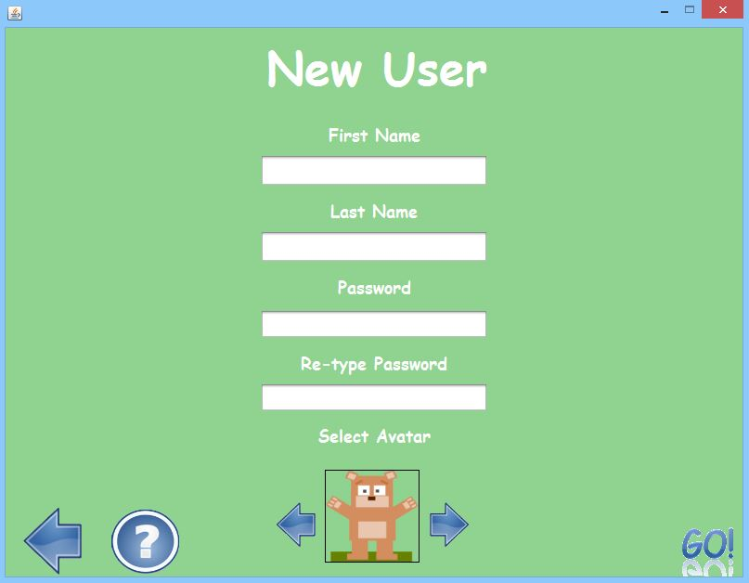
New user!
3.4.1 If the user doesn't have a account, the user shall create an account.
3.4.2 the user shall enter a user name.
3.4.3 The User shall enter a password while creating an account.
3.4.4 The User shall reenter the password while creating an account.
3.1.1 The interface shall be easy to use, user friendly and be understandable for children
3.1.2 Each window will have a button returning them to the previous window.
3.1.3 On all windows, the system shall have a help.
3.1.4 The help button shall give a short explanation/tutorial of the current activity.
3.1.5 The system will load png and txt files from the corresponding help folder.

Slide 8
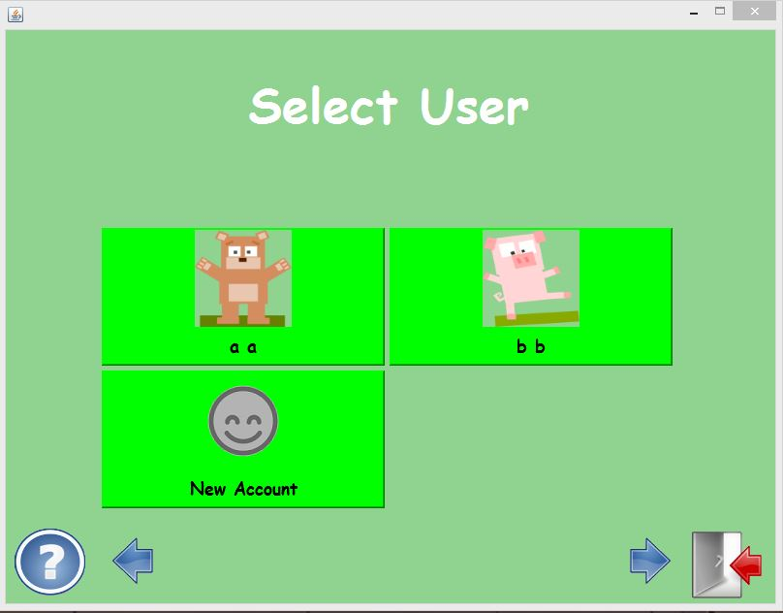
Select user!
3.4.5 The system shall prompt the user to select an account from a preexisting user list.
3.4.6 After choosing an existing account the user shall enter a password.
3.4.7 The user shall be able to log out in the main window.
3.4.8 The log-in list shall be constructed from the database.

Slide 9
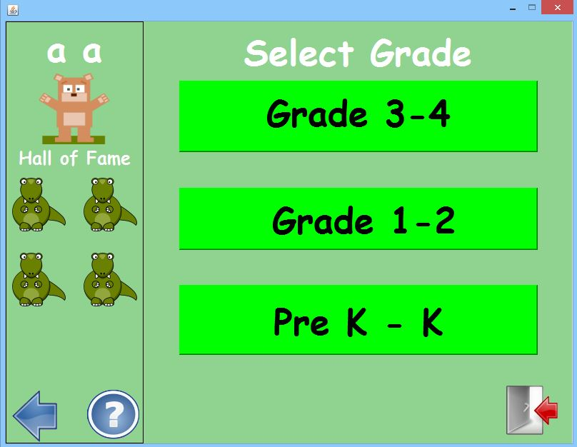
Select grade
3.1.1 The interface shall be easy to use, user friendly and be understandable for children
3.1.2 Each window will have a button returning them to the previous window.
3.1.3 On all windows, the system shall have a help.
3.1.4 The help button shall give a short explanation/tutorial of the current activity.
3.1.5 The system will load png and txt files from the corresponding help folder.

Slide 10
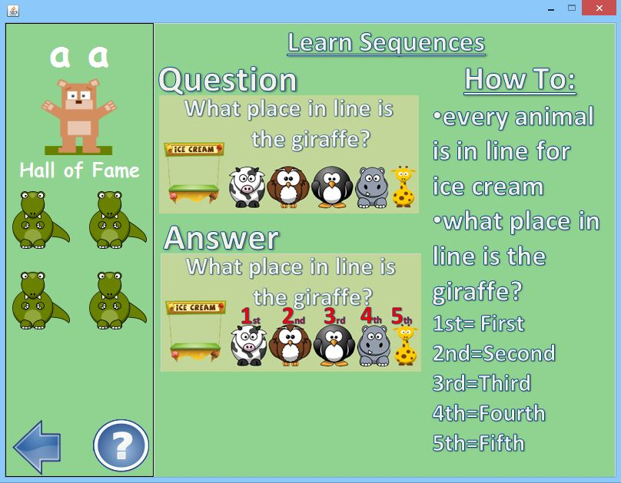
Tutorial
3.2.1 The user shall take tutorials.
3.2.2 Tutorials shall use pictures to teach users.
3.2.3 Tutorials shall use words to teach users.
3.2.4 The tutorial shall teach Number sense and operation skills.
3.2.5 The Tutorials will be load the images and text file from a folder.
3.2.6 The folder will have a text file and png files.

Slide 11
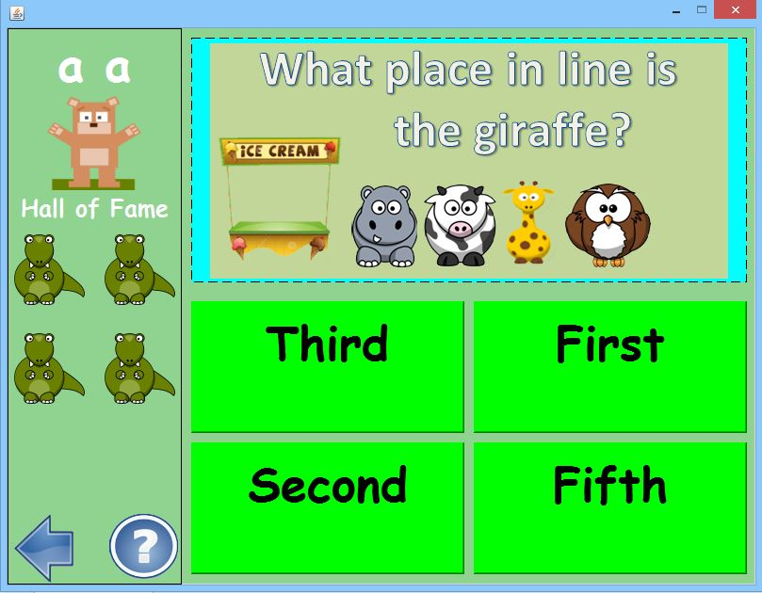
Testing
3.3.1 The user shall take tests after tutorials.
3.3.2 The test questions shall be multiple choice.
3.3.3 The tests shall have questions on Number sense and operation skills.
3.3.5 The system shall increase the difficulty of the tests.
3.3.6 After completing a test or math level, the system shall give the user stickers.

Slide 12
Testing
3.3.7 The system will create tests both randomly and from a pre-made list of questions.
3.3.8 The pre made list of questions shall be loaded from a file.
3.3.9 Any image shall be loaded from a folder
3.3.10 Pre k – k tests will have 6 questions
3.3.11 Pre k - k tests shall be passed if the user gets 3/6 correct.
The user shall take tests after tutorials.
3.3.2 The test questions shall be multiple choice.
3.3.3 The tests shall have questions on Number sense and operation skills.
3.3.5 The system shall increase the difficulty of the tests.

Slide 13
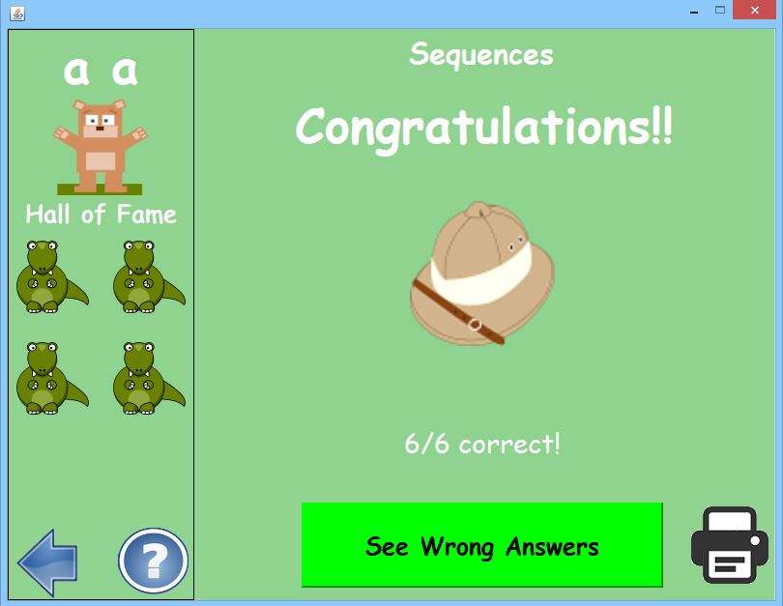
Rewards
3.3.6 After completing a test or math level, the system shall give the user stickers.
3.5.1 The system shall give the user a report of a completed test.
3.5.2 The reports shall be printable.
3.5.3 The reports will show percentage correct
3.5.4 The reports will show pass/fail
3.5.5 The reports will show incorrect questions with the correct answer.

Slide 14

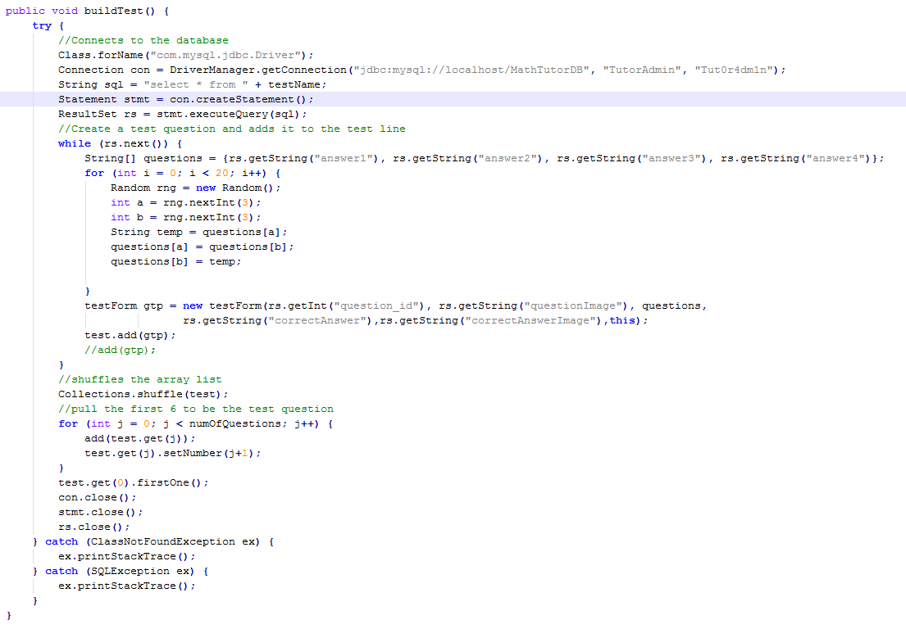
Build test

Slide 15
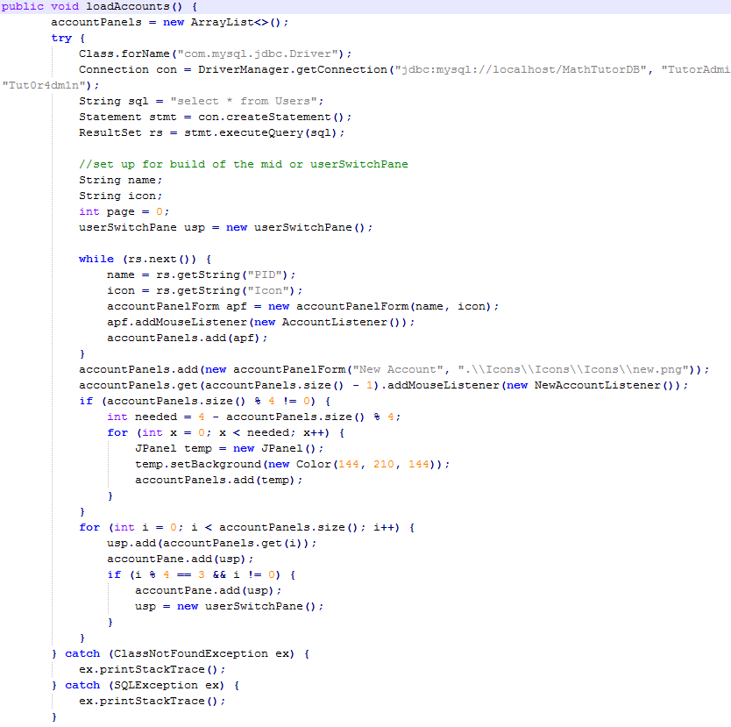

Load accounts

Slide 16

Final words…
To be added
Video tutorials
Full screen mode
More modules
DEMONSTRATION!

